Slide 1


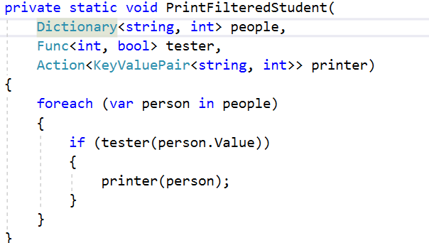


Functional Programming
Lambda Expressions
Advanced
C#
SoftUni Team
Technical Trainers
Software University
http://softuni.bg

Slide 2

Table of Contents
Functional Programming Paradigms
Lambda Expressions
Action<T>, Func<T>
Passing Functions to Methods
λ

Slide 3
Questions
sli.do #Csharp-Advanced

Slide 4
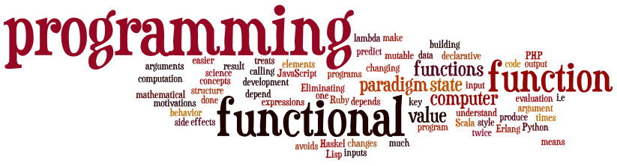
Functional Programming
Paradigms, Concepts
Notes:
Functional programming is a programming paradigm
Uses computations of mathematical functions to build programs
Declarative programming paradigm (not imperative)
Pure-functional languages (no variables and loops): Haskell
Almost-functional: Clojure, Lisp, Scheme, Scala, F#, JavaScript
Imperative with functional support: C#, Python, Ruby, PHP, Java
Non-functional: C, Pascal, the old versions of C#, Java, C++, PHP

Slide 5
What is Function?
Mathematic function
f(x) = x²
x
f(x)
Name
3 | 9
1 | 1
0 | 0
4 | 16
-4 | 16
Input
Output
A function is a special relationship where each input has a single output.

Slide 6

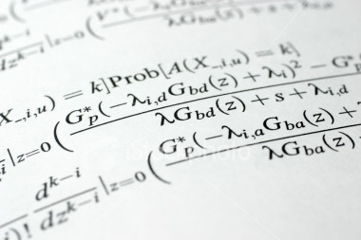
Lambda Expressions

Slide 7
Lambda Expressions
A lambda expression is an unnamed function with parameters and a body
Lambda syntax
Use the lambda operator ->
Read as "goes to"
Parameters can be enclosed in parentheses ()
The body holds the expression or statement and can be enclosed in braces {}
(parameters) => {body}

Slide 8
Lambda Expressions (2)
Implicit lambda expression
Explicit lambda expression
Zero parameters
More parameters
msg => Console.WriteLine(msg);
(String msg) => { Console.WriteLine(msg); }
() => { Console.WriteLine("hi"); }
(int x, int y) => { return x + y; }

Slide 9

Problem: Sort Even Numbers
Read Integers from console
Print even numbers
Print sorted even numbers
Use 2 Lambda Expresions
4, 2, 1, 3, 5, 7, 1, 4, 2, 12
2, 2, 4, 4, 12

Slide 10
Solution: Sort Odd Numbers
Console.ReadLine()
.Split(new string[] { " " },
StringSplitOptions.RemoveEmptyEntries)
.Select(n => int.Parse(n))
.Where(n => n % 2 != 0)
.OrderBy(n => n)
.ToList()
.ForEach(n => Console.WriteLine(n));
Check your solution here: https://judge.softuni.bg/Contests/597/Functional-Programming-Lab

Slide 11


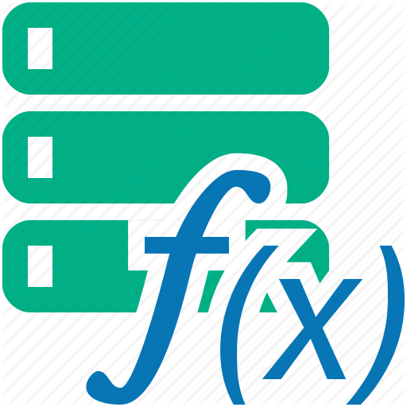
Lambda Expressions
Exercises in class

Slide 12
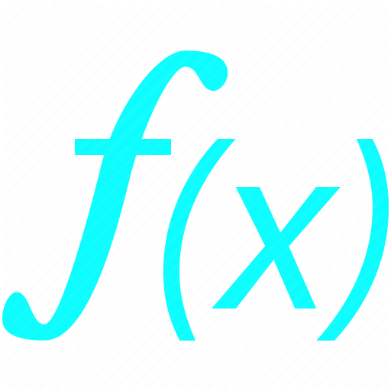




Functions
C# Functions
Notes:
Functional programming is a programming paradigm
Uses computations of mathematical functions to build programs
Declarative programming paradigm (not imperative)
Pure-functional languages (no variables and loops): Haskell
Almost-functional: Clojure, Lisp, Scheme, Scala, F#, JavaScript
Imperative with functional support: C#, Python, Ruby, PHP, Java
Non-functional: C, Pascal, the old versions of C#, Java, C++, PHP

Slide 13
C# Func
Lambda Expressions
Initialization of function
Input and output type can be different type
Input and output type must be from type which we declare them
Func<int, string> func = n -> n.toString();
Input type
Output type
Name
Input parameter
Return expression

Slide 14
Action<T>
In .NET Action<T> is a void method:
Instead of writing the method we can do:
Then we use it like that:
private void Print(string message)
{ Console.WriteLine(message); }
Action<string> print = message => Console.WriteLine(message);
print(“pesho”);
print(5.ToString());

Slide 15
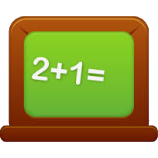

Problem: Sum Numbers
Read numbers from console
Use your own Function for parse
Print Count of numbers
Print Sum
4, 2, 1, 3, 5, 7, 1, 4, 2, 12
10
41

Slide 16
Solution: Sum Numbers
var numbers = Console.ReadLine();
Func<string, int > parser = n => int.Parse(n);
Console.WriteLine(numbers.Split(new string[] {", "},
StringSplitOptions.RemoveEmptyEntries)
.Select(parser)
.Sum());
Check your solution here: https://judge.softuni.bg/Contests/597/Functional-Programming-Lab

Slide 17

Problem: Count Uppercase Words
Read text from console
Count how many words start with Uppercase
Print count and words
Use Predicate
The following example shows how to use Predicate
The
Predicate

Slide 18
Solution: Count Uppercase Words
var words = Console.ReadLine().Split(new string[] {" "},
StringSplitOptions.RemoveEmptyEntries);
Func<string, bool> checker = n => n[0] == n.ToUpper()[0];
words.Where(checker)
.ToList()
.ForEach(n => Console.WriteLine(n));
Check your solution here: https://judge.softuni.bg/Contests/597/Functional-Programming-Lab

Slide 19


Problem: Add VAT
Read from console some item's prices
Add VAT of 20% to all of them
Use UnaryOperator
Prices with VAT:
1,66
3,07
5,28
1.38, 2.56, 4.4

Slide 20
Solution: Add VAT
Console.ReadLine()
.Split(new string[] { ", " },
StringSplitOptions.RemoveEmptyEntries)
.Select(double.Parse)
.Select(n => n * 1.2)
.ToList()
.ForEach(n => Console.WriteLine($"{n:n2}"));
Check your solution here: https://judge.softuni.bg/Contests/597/Functional-Programming-Lab

Slide 21
Action<T> and Func<T>
Exercises in class

Slide 22
Passing Functions to Method
We can pass Func<T> to methods:
We can use the method like that:
private int Operation(int number, Func<int, int> operation)
{
return operation(number);
}
int a = 5;
int b = Operation(a, number => number * 5);
int c = Operation(a, number => number – 3);
int d = Operation(b, number => number % 2);

Slide 23
Problem: Filter by Age
Read from console n people with their age
Read condition and age for filter
Read format type for output
Print all people that fulfills the condition
Pesho | 20
Gosho | 18
Radka | 29
Mara | 32
Izdislav | 16
Condition - "older"
Age - 20
Format - "name age"
Pesho | 20
Radka | 29
Mara | 32

Slide 24
Solution: Filter by Age
//TODO: Read info from console
//Implementation of these methos on next slides
Func<int, bool> tester = CreateTester(condition, age);
Action<KeyValuePair<string, int>> printer =
CreatePrinter(format);
PrintFilteredStudent(people, tester, printer);
Check your solution here: https://judge.softuni.bg/Contests/597/Functional-Programming-Lab

Slide 25
Solution: Filter by Age (2)
public static Func<int, bool> CreateTester
(string condition, int age)
{
switch (condition)
{
case "younger": return x => x < age;
case "older": return x => x > age;
default: return null;
}
}
Check your solution here: https://judge.softuni.bg/Contests/597/Functional-Programming-Lab

Slide 26
Solution: Filter by Age (3)
public static Action<KeyValuePair<string, int>>
CreatePrinter(string format)
{
switch (format)
case "name":
return person => Console.WriteLine($"{person.Key}");
case "age":
return person => Console.WriteLine($"{person.Value}");
case "name age":
return person =>
Console.WriteLine($"{person.Key} – {person.Value}");
default: return null;
}
Check your solution here: https://judge.softuni.bg/Contests/597/Functional-Programming-Lab

Slide 27
Passing Functions to Method
Exercises in class

Slide 28
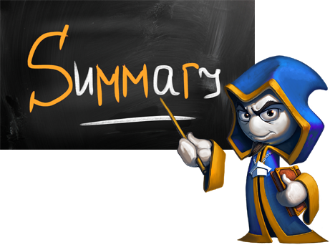
Summary
Lambda expressions are anonymous functions used with delegates
Action<T> is a void function
Func<T, TResult> is a function that returns TResult type

Slide 29








Functional Programming
https://softuni.bg/courses/advanced-csharp

Slide 30

License
This course (slides, examples, demos, videos, homework, etc.) is licensed under the "Creative Commons Attribution-NonCommercial-ShareAlike 4.0 International" license
Attribution: this work may contain portions from
"Fundamentals of Computer Programming with C#" book by Svetlin Nakov & Co. under CC-BY-SA license
"OOP" course by Telerik Academy under CC-BY-NC-SA license

Slide 31






Free Trainings @ Software University
Software University Foundation – softuni.org
Software University – High-Quality Education, Profession and Job for Software Developers
softuni.bg
Software University @ Facebook
facebook.com/SoftwareUniversity
Software University @ YouTube
youtube.com/SoftwareUniversity
Software University Forums – forum.softuni.bg

